Slide 1

SMART WASTE BIN MANAGEMENT USING IOT
Faculty Guide:
PROF. SIBU SKARIA
ASSOCIATE PROFESSOR
By
ABIN JOSE
MAC23MCA-2005

Slide 2

CONTENTS
INTRODUCTION
LITERATURE REVIEW
PROJECT PROPOSAL
COMPONENTS
BLOCK DIAGRAM

Slide 3
INTRODUCTION
Problems existing in waste management?
Overflowing bins, High workload of sanitation workers, Unhygenic Conditions, environmental impact
The goal is to address the issues of waste management in urban areas by using smart Waste bins.
Importance of efficient waste management in urban areas?
environmental protection, public health, urban cleanliness, economic benefits, sustainability, climate change
How IoT can transform waste management practices?
real-time monitoring, optimizing collection routes, reducing costs, improving environmental cleanliness

Slide 4
LITERATURE REVIEW - 1
TITLE | AUTHOR | COMPONENTS | METHODOLOGY
Intelligent waste management system using deep learning with IoT | Rahman MW, Islam R, Hasan A, Bithi NI, Hasan MM, Rahman MM. | Raspberry pi Ultrasonic sensor Camera Module ESP8266 Node MCU Servo Motor Load Measurement Sensor Android Application GSM Module Roller Waste Bin | CNNs such as AlexNet, VGG16, and ResNet34. Sensors: Ultrasonic, load measurement. Usage of servomotor, alert systems.

Slide 5
LITERATURE REVIEW - 2
TITLE | AUTHOR | COMPONENTS | METHODOLOGY
Smart prediction and monitoring of waste disposal system using IoT and cloud for IoT based smart cities | John J, Varkey MS, Podder RS, Sensarma N, Selvi M, Santhosh Kumar SV, Kannan A | Arduino Microcontroller Ultrasonic sensor Infrared Sensor Weight Sensor GPS Module Temperature and Humidity Sensors Accelerometer(ADXL335) LED Indicators ESP8266 Wifi Module Firebase Cloud Database | IR,UV, weight sensors are used... GPS Module LSTM neural network predicts future waste patterns

Slide 6
LITERATURE REVIEW - 3
TITLE | AUTHOR | COMPONENTS | METHODOLOGY
An internet of things based smart waste system | Jasim AM, Qasim HH, Jasem EH, Saihood RH. | ESP32Wi-Fi Microcontroller Ultrasonic sensor Conveyor Belt Brushless DC Motor with Driver Circuit DHT22 Sensors Servo Motor LCD with I2C Board GSM Module GPS Module Blynk Mobile Application Waste Bin | DHT22 sensors used..

Slide 7

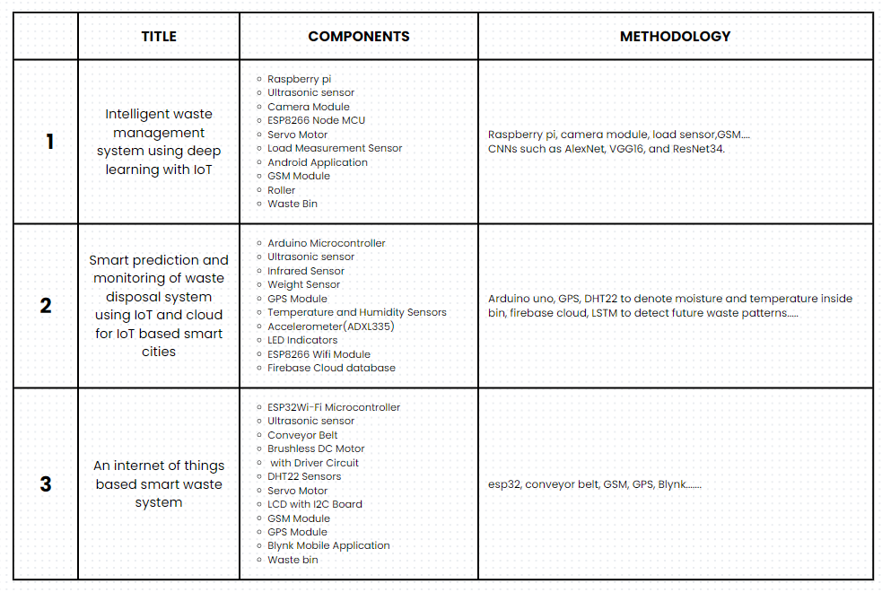


Slide 8
PROPOSED SYSTEM
Objective: create efficient and automated system for managing waste collection and disposal in urban areas. The system aims to monitor waste levels in real-time, optimize collection routes, reduce operational costs, and improve environmental cleanliness
Overview: Ultrasonic sensors detect waste levels and automatically open the bin cover, servo motor. Load sensors measure the quantity of waste. GPS module tracks bin location. RFID readers identify users and promote proper waste disposal. cloud features, android app, alerting mechanisms .........

Slide 9
COMPONENTS
·Arduino Uno
·ESP8266 Wifi Module
·HC-SR04 Ultrasonic Sensors
·HX711 Load cell
·SG90 Servo motor
·16x2 LCD Screen
·GPS Module
·Piezo Buzzers
·RFID Reader, RFID tags
·Protective Diodes
·I2C Module
·Battery pack
·Jumper Wires and Breadboard

Slide 10
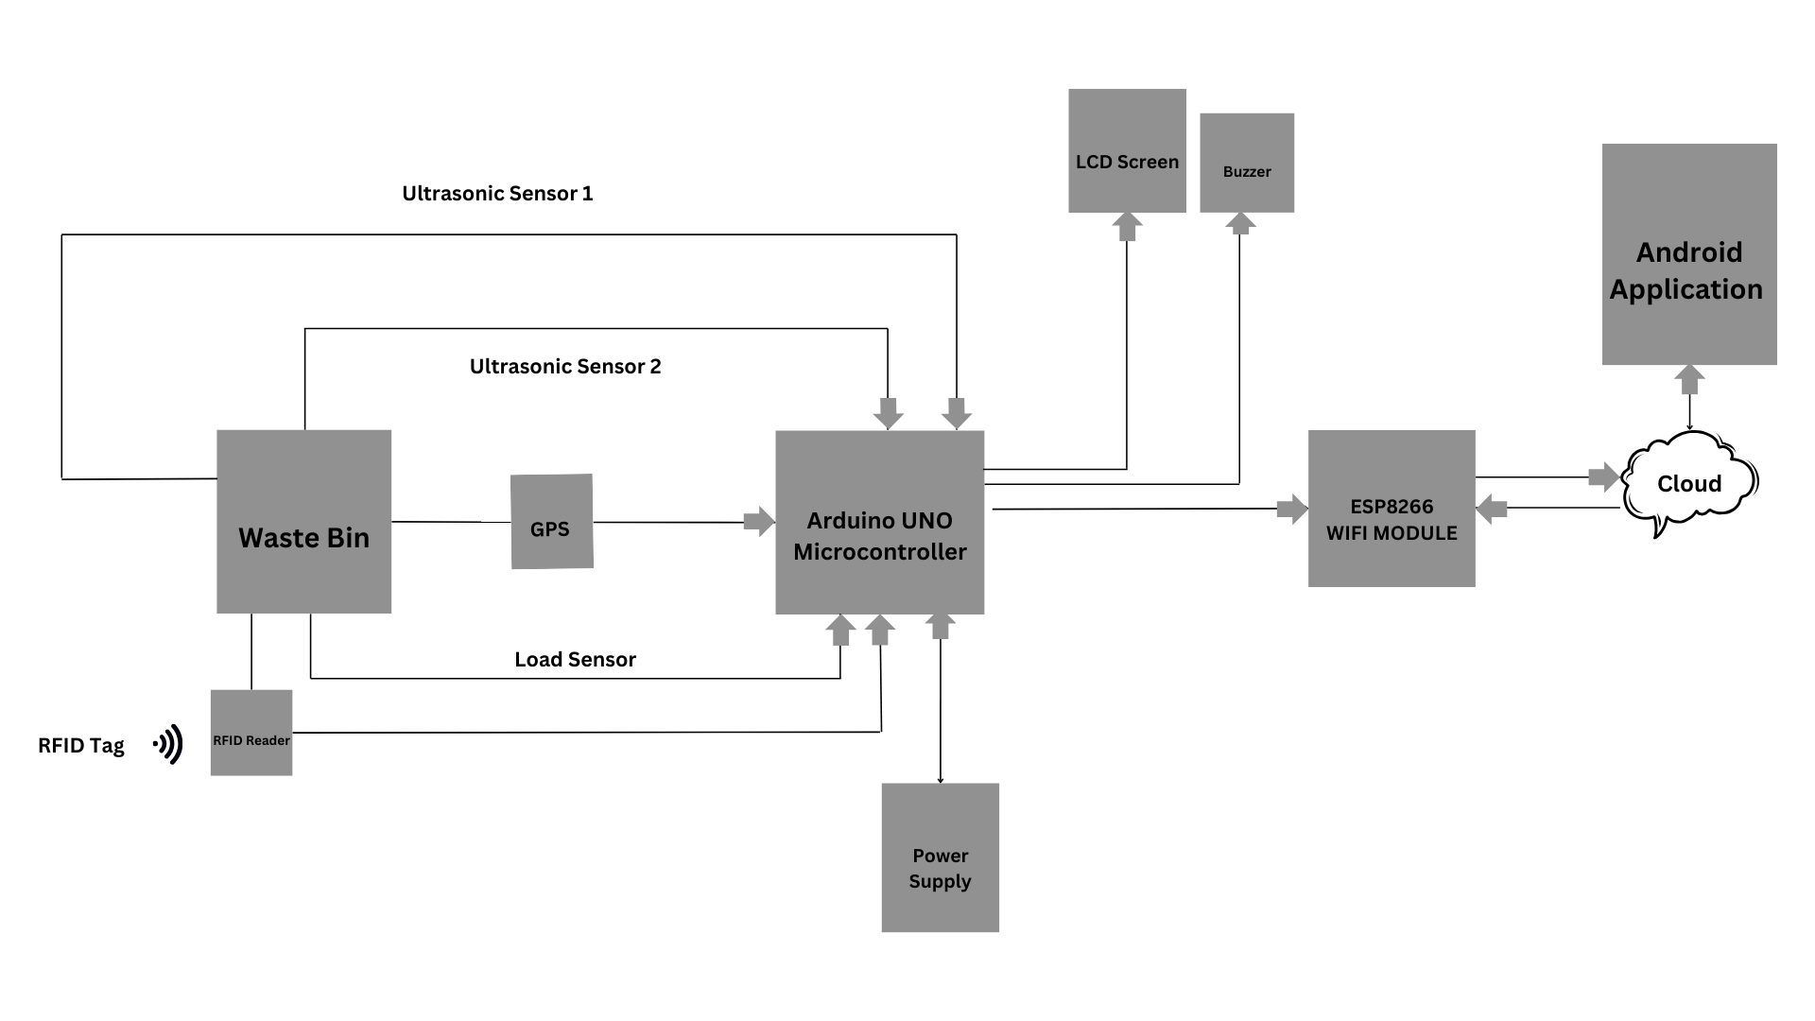
BLOCK DIAGRAM

Slide 11
THANK YOU

